Slide 1
The Presentation
Chp13G,H

Slide 2
Maturity is the capacity to endure uncertainty.
——John Finley

Slide 3
uncertainty
outlier

Slide 4
outlier
In statistics, an outlier is a data point that differs significantly from other observations.
1，1，2，3，4，5，6，7，8，9，10000
Notes:
We have seen that outliers are extraordinary data that are separated from the main body of the data.
However, we have so far identified outliers rather informally by looking at the data directly, or at a column graph of the data.

Slide 5
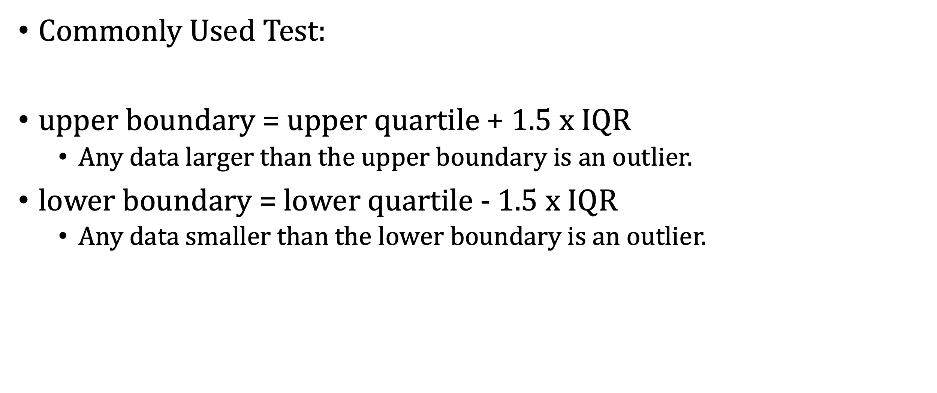
finding outlier

Slide 6
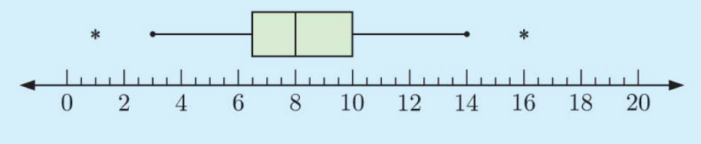
locating outlier
Mark outliers with an asterisk on a box plot.
Each whisker extends to the last value that is not an outlier

Slide 7
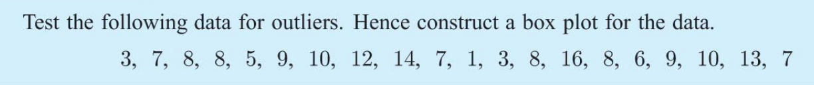
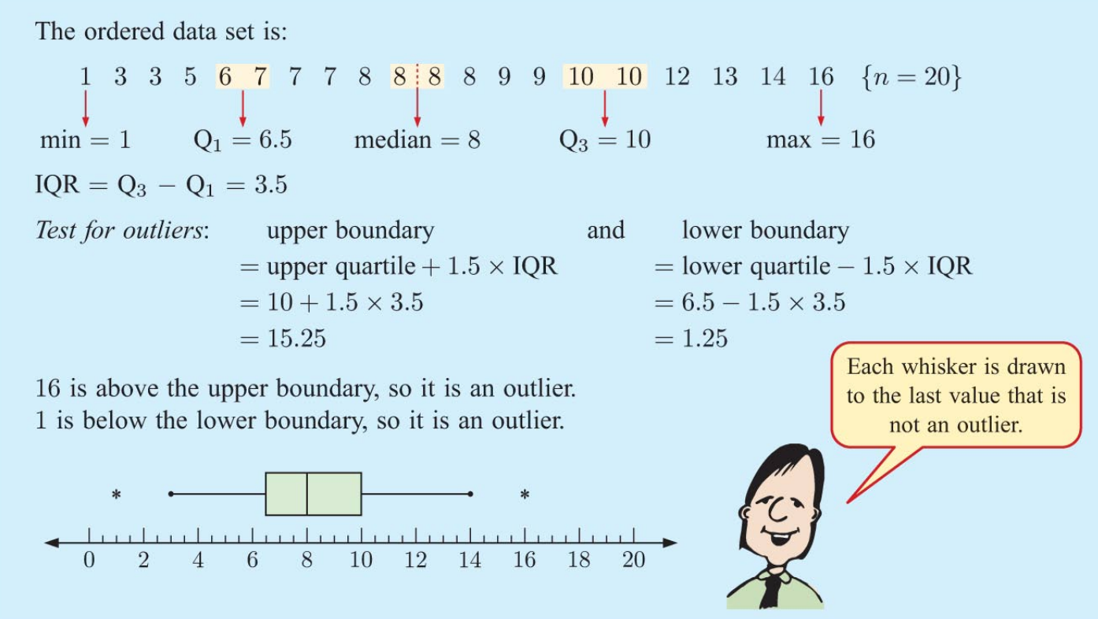

Slide 8
How to solve this kind of problems?
1. 将这些数据从小到大排列
2. 找出min，Q1，median，Q3，max，IQR
3. 算出upper boundary和lower boundary
4. 看有没有outliers
5. 画box plot（outliers用*表示，不在lower whisker和upper whisker内）

Slide 9
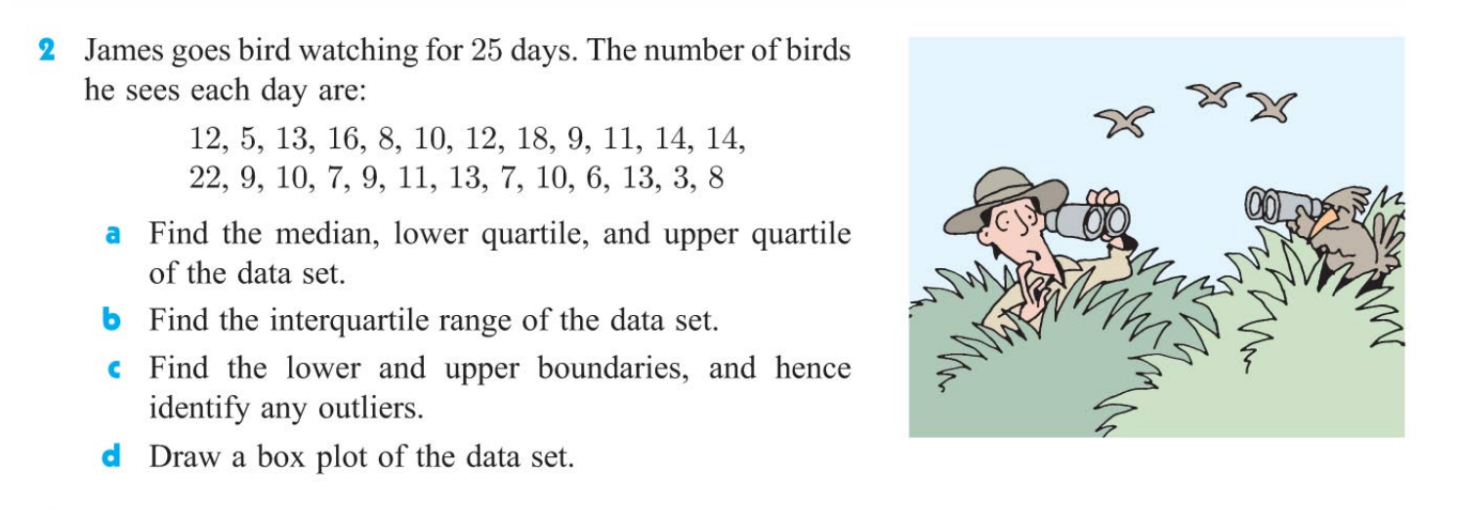
3, 5, 6, 7, 7, 8, 8, 9, 9, 9, 10, 10, 10, 11, 11, 12, 12, 13, 13, 13, 14, 14, 16, 18, 22
a. median = 10, Q1 = 8, Q3 = 13
b. IQR = Q3 – Q1 = 5
c. upper boundary = 13 + 1.5*5 = 20.5,
lower boundary = 8 – 1.5*5 = 0.5

Slide 10
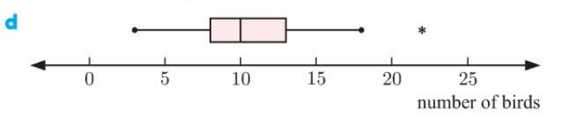
Median = 10, Q1 = 8, Q3 = 13
IQR = 5
Lower = 0.5, Upper = 20.5, 22 is an outlier

Slide 11
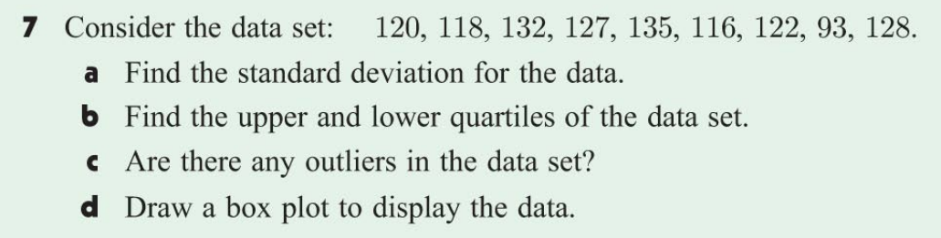
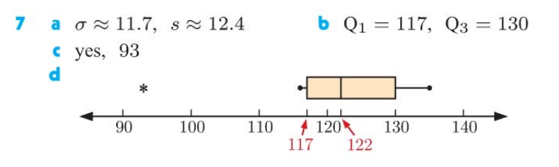

Slide 12
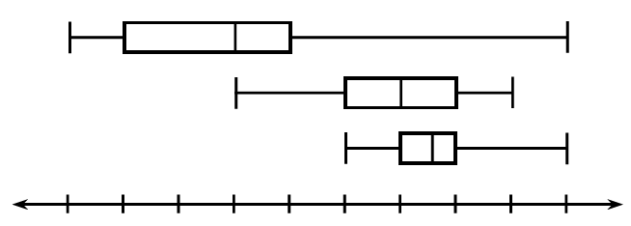
Visualization
Easy to Compare!
A parallel box and whisker diagram or parallel box plot enables us to make a visual comparison of the distributions of two data sets. We can easily compare descriptive statistics such as their median, range, and interquartile range.

Slide 13
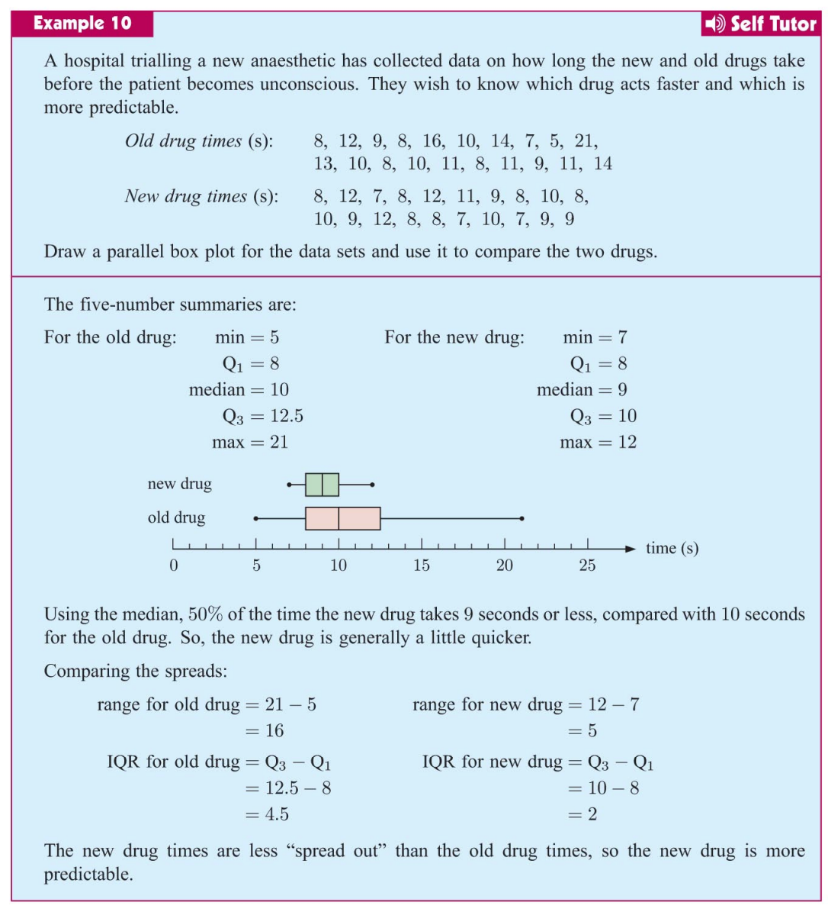
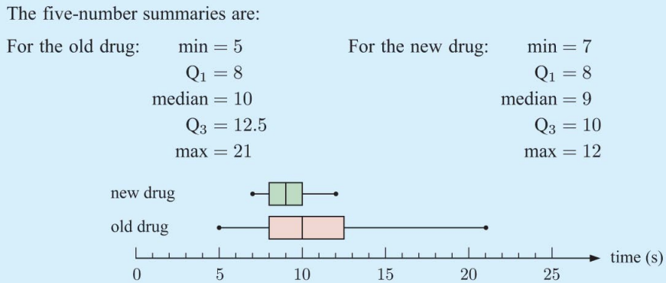
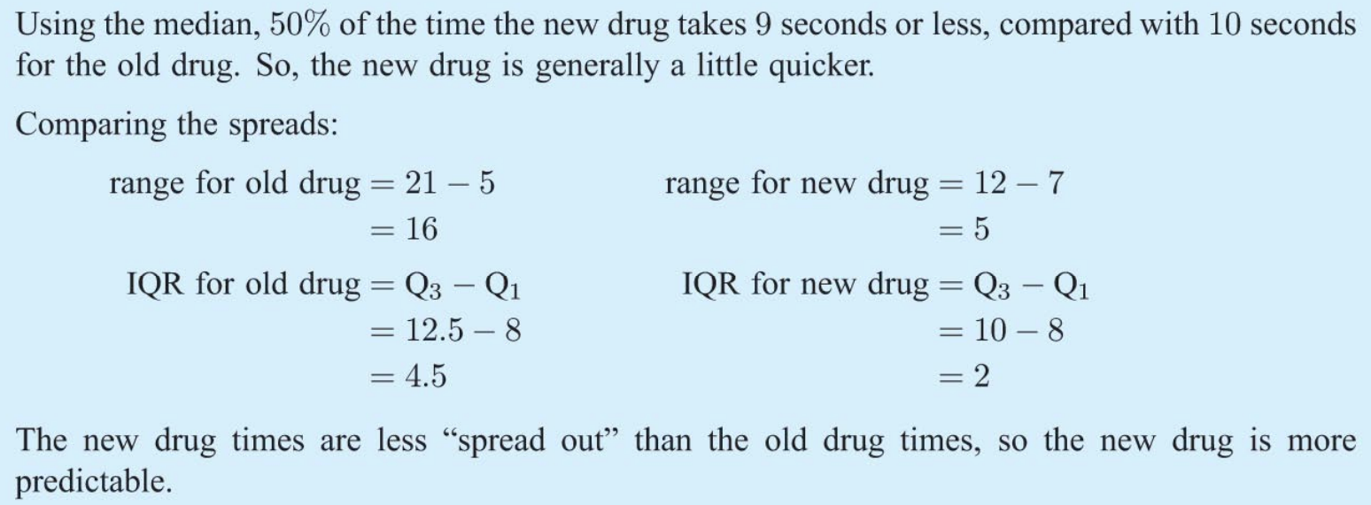

Slide 14
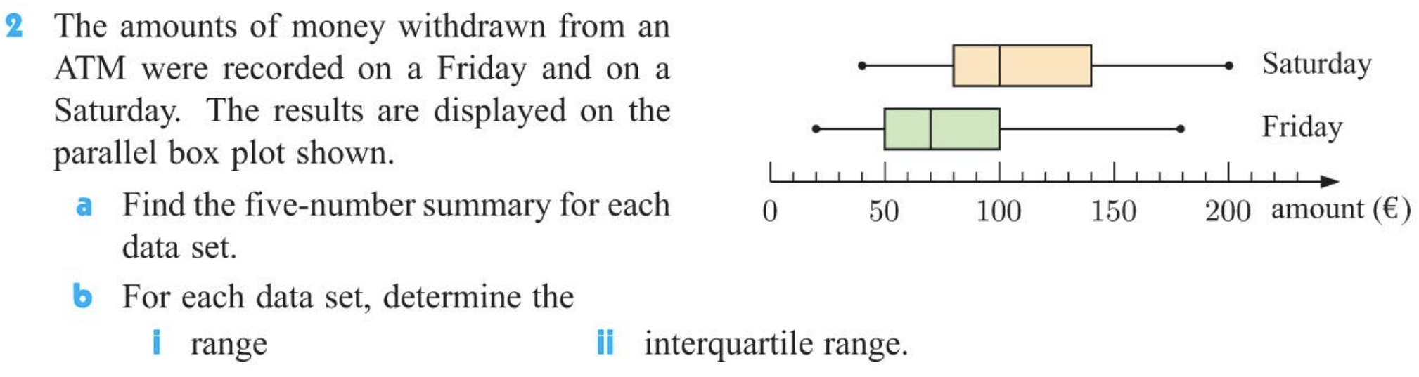
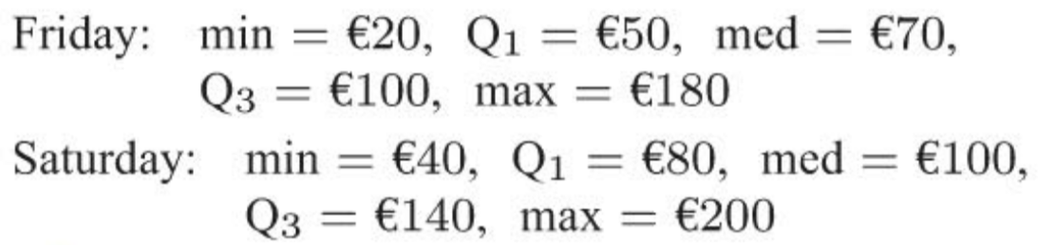
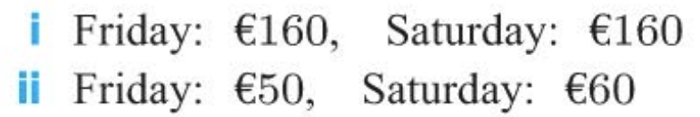

Slide 15
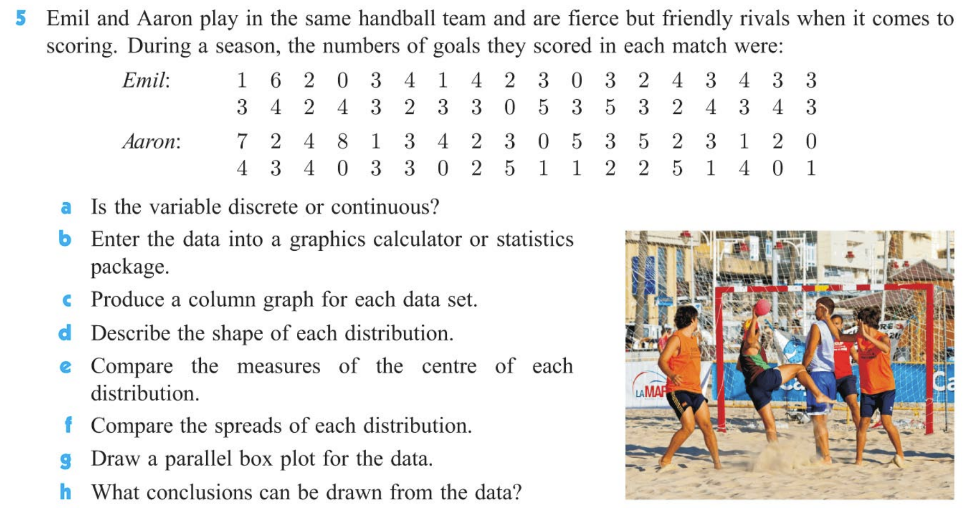
Discrete

Slide 16
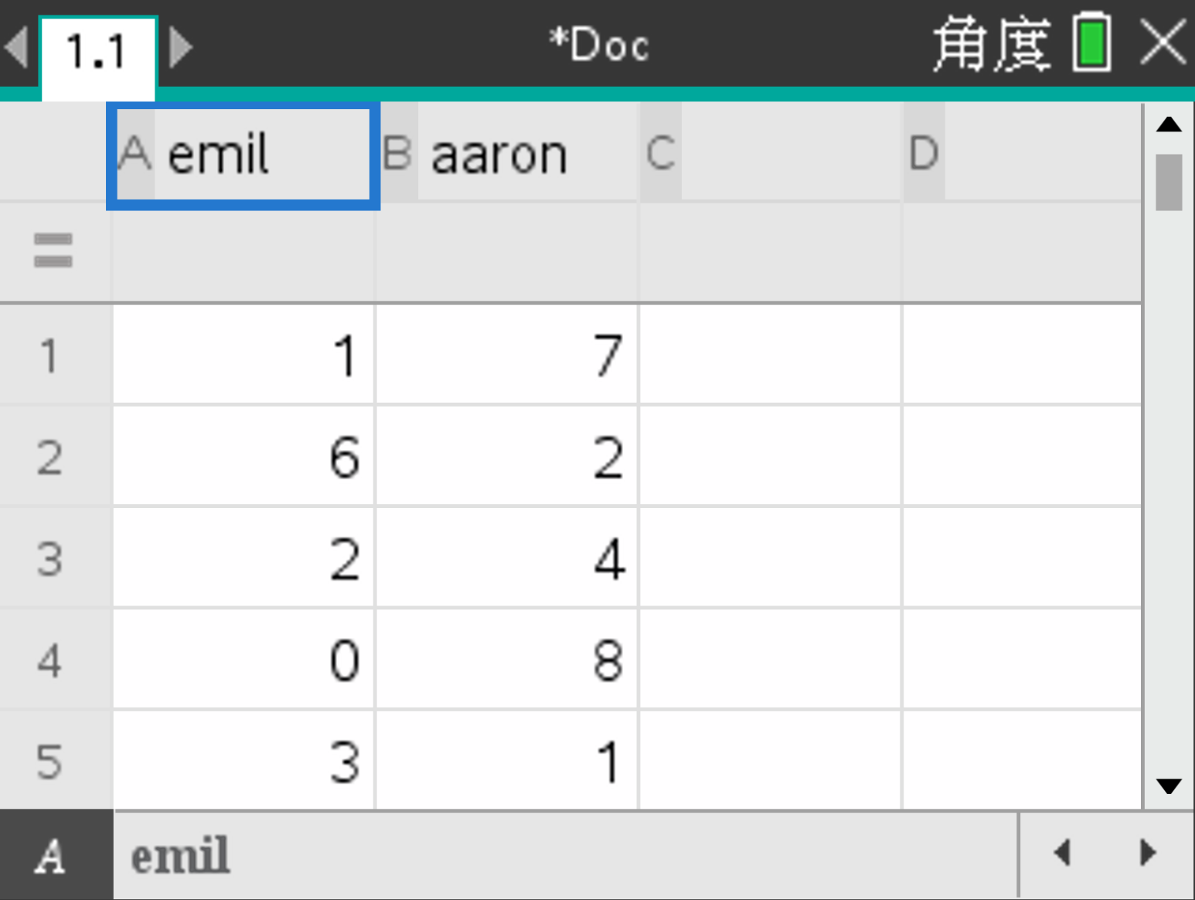
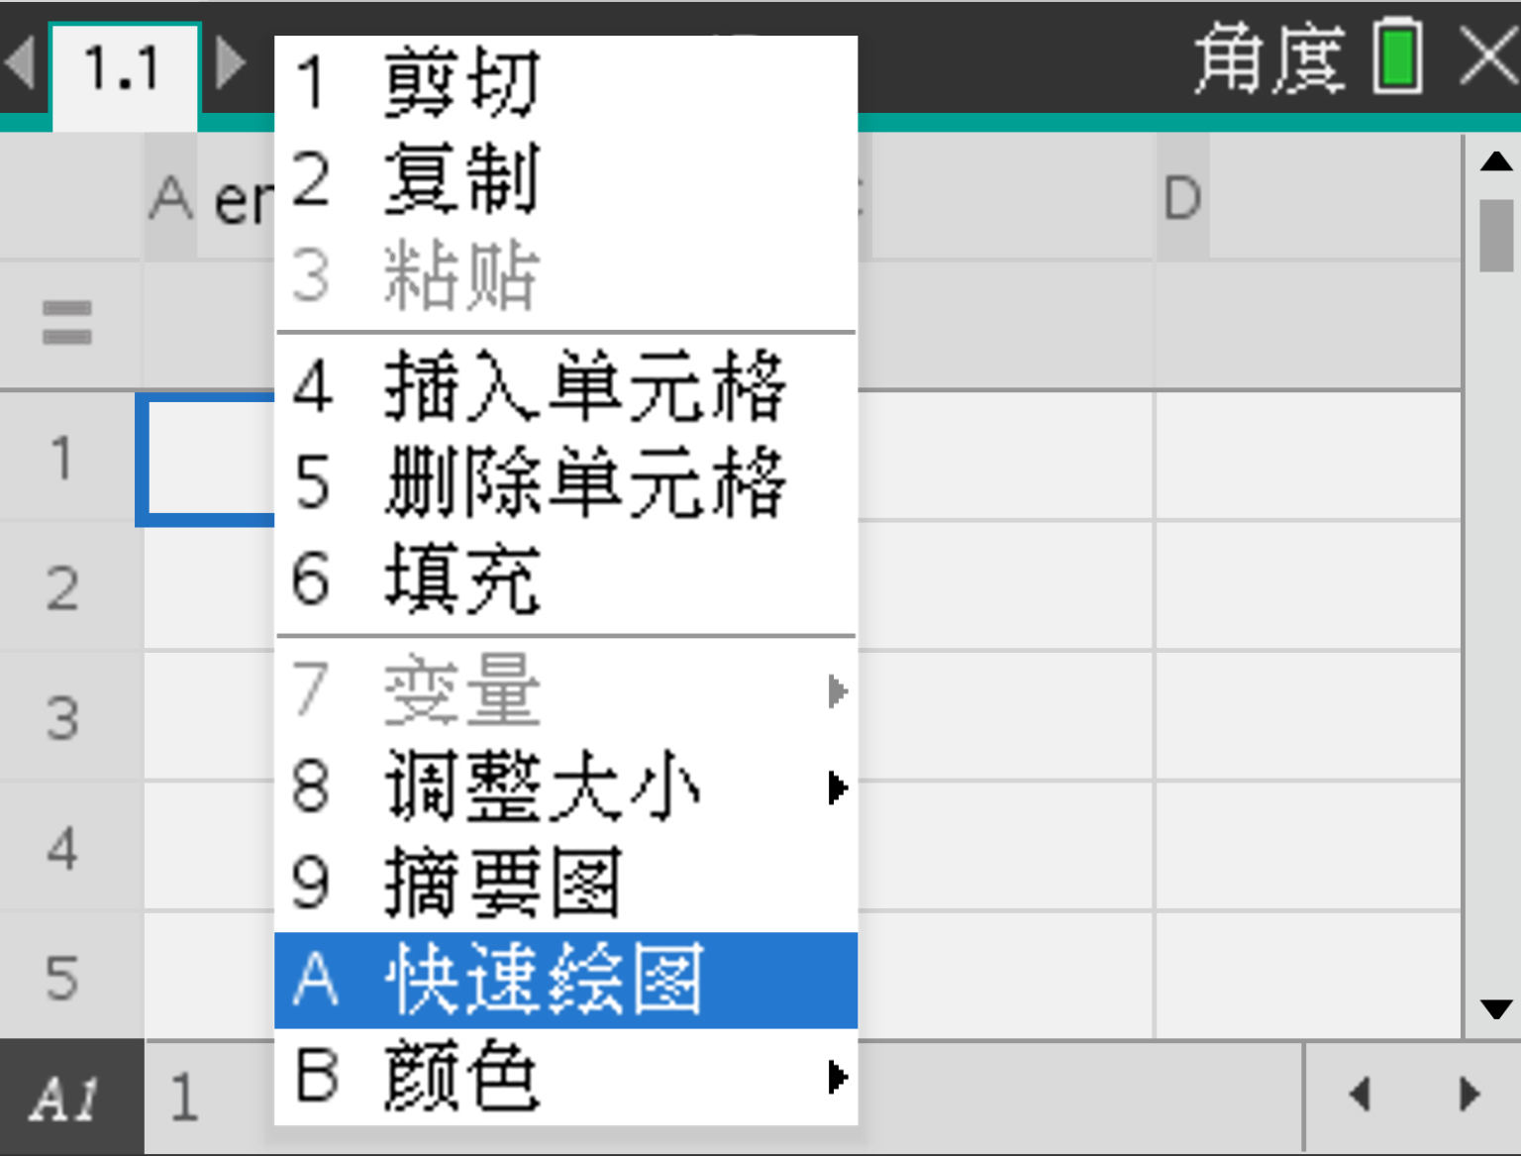
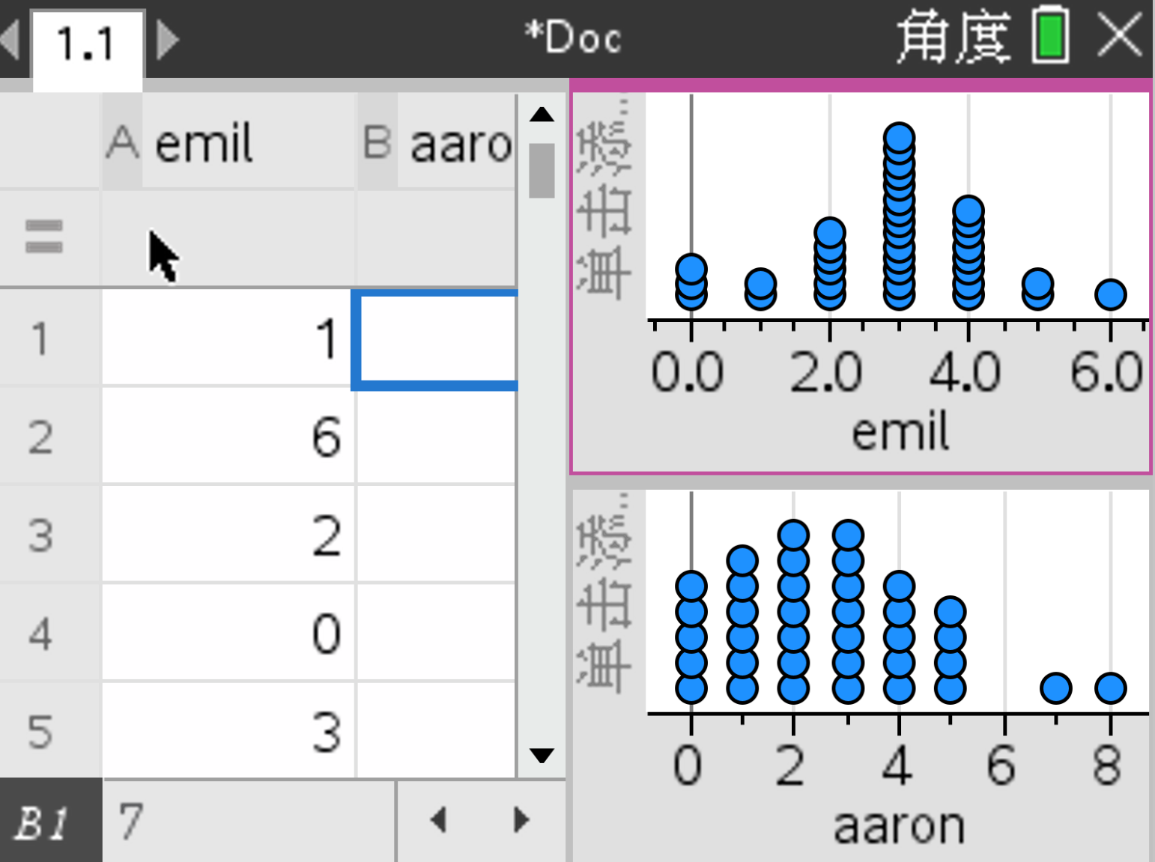
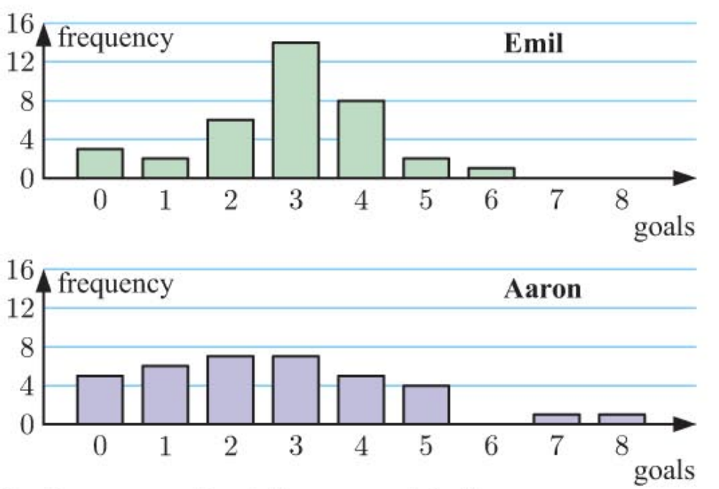

Slide 17
Approximately
Symmetrical
Positively skewed

Slide 18
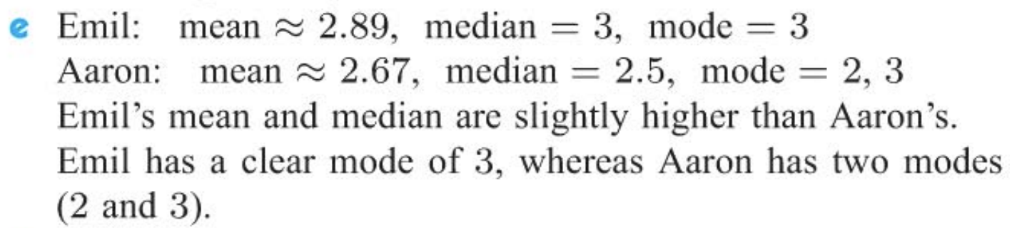
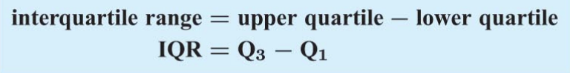
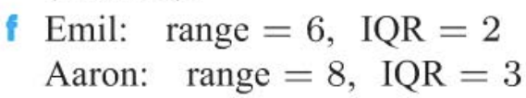
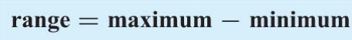

Slide 19
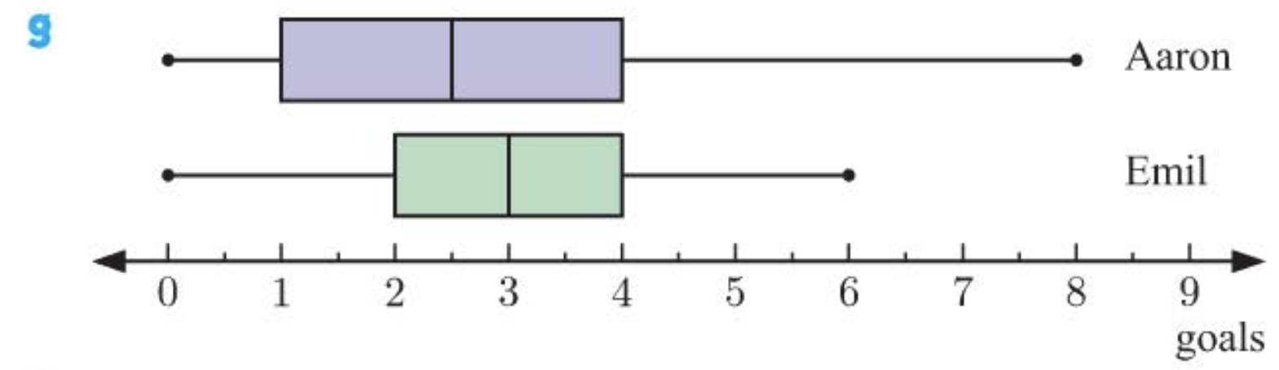
Emil is more consistent with her scoring
Emil is the steadier player among the two

Slide 20
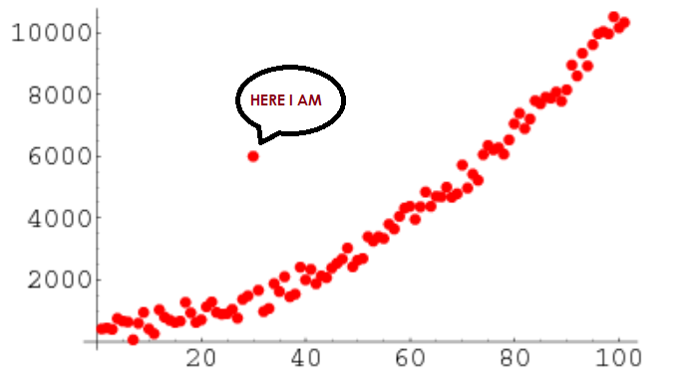
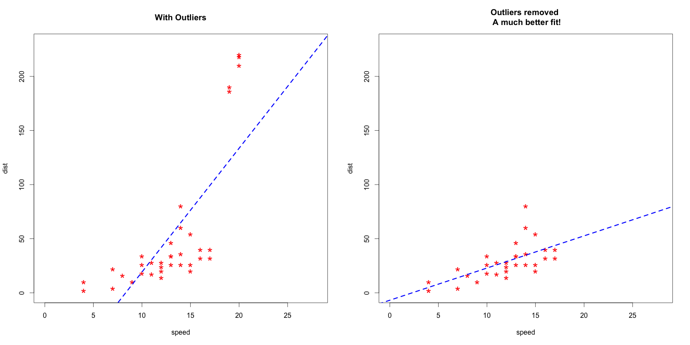
Outliers? Outliers!
Notes:
All of my friends did a good job. I believe you've all got a fundamental understanding of outliers. Yet we've just scratch the surface of this vital concept, 1 which is inevitable when it comes to statistics. So now, after having introduced you the notion and ways and means of identifying and visualizing them, the burden of talking about how to deal with it falls on my shoulder.

Slide 21


Outliers? Outliers!
1. Look for a plausible explanation
2. Find out the impact of removing, including data size, the meaning of the data
Think Twice!
3. Transform data with
log transforms or Winsorization
Notes:
Upon encountering deviated data,1 we should ask ourselves a question: Does it has a interpretation?
1 Perhaps the outlier represents a high-income earner living in this location, 1 or maybe it’s a measurement error.
1 And then, before excluding the data, you’ll have to consider the consequences of doing so by looking into the data size, or the meaning of the unexpected value. Removing outliers could significantly alter the distribution of the data, and possibly turn the conclusions drawn from the analysis upside down.
1 And if you decide to keep the anomalies in your data set, you may transform your data using different approaches.
By applying them, their discrepancies can be modified.
Above all, we should be cautious dealing with outliers, think twice before doing anything to raw data.
Well, I believe this is the end of the our presentation. Thanks for your attention and time. If you have any question, you can raise it now.

